Slide 1
Game co case study
Austin Crehan

Slide 2
Game co
Overview: You’re an analyst for a new video game company, GameCo, which wants to use data to inform the development of new games. As such, you’ve been asked to perform a descriptive analysis of a video game data set to foster a better understanding of how GameCo’s new games might fare in the market.
Objective: Conduct a descriptive analysis to help Game Co better understand the global video game market.
DATA
TOOLS
SKILLS
Global video game sales from 1980-2016
Data provided by VGZChartz
Original dataset
Excel
Translating business requirements
Data cleaning
Data integration
Data transformation
Pivot tables
Hypothesis testing
Forecasting
Data visualization with Excel

Slide 3
Analyzing genre popularity
Genre sales by geographic region
Shooter
By far the most popular genre in North America
Much less popular in Japan and Europe
Note: Within North America, there is a wide-range of gun-control laws, ownership, and overall gun popularity, particularly between the two largest countries in the region, the United States and Canada – how does this impact popularity?
Sports
Remain popular across all regions
Note: Within the different regions, there is a wide-range of sports popularity (I.e., the most popular sport in North America is American football, Europe is soccer/European football, Japan is baseball) – how does this impact popularity?

Slide 4
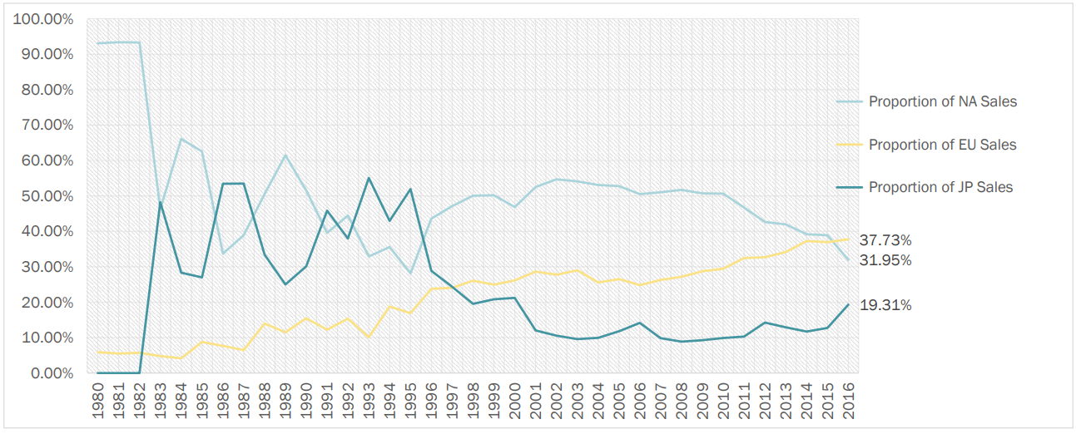
Analyzing global market share
Proportion of sales by geographic region
North America
Very high market share in 1980s as other markets were introduced
Market share ranging from 30-60% after market integration
Steady decrease in market share since 2010
20-year low market share (31.95%) in 2016
Europe
Steady increase in market share since market integration
Overtook Japan in market share in 1997
Overtook North America in market share in 2015
All-time high market share (37.73%) in 2016
Japan
Second largest market share after market integration, ranging from 25-55%
From 1995-2010 market share steadily decreased to single digits
Since 2010, market share has rebounded, hitting a 15-year high (19.31%) in 2016

Slide 5
Game co recap
RESULTS
FURTHER ANALYSIS TO CONDUCT
Shooter the most popular genre in North America
Sports remain popular across all regions
Shooter, Sports, and Action genres account for over 75% of total market share
North American market share has fallen to a 20-year low (31.95%)
Europe market share has risen to an all-time high (37.73%)
Japan market share has risen to a 15-year high (19.31%)
Within North America, there is a wide-range of gun-control laws, ownership, and overall popularity, particularly between the two largest countries in the region, the United States and Canada – how does this impact Shooter genre popularity?
Within the different regions, there is a wide-range of sports popularity (I.e., the most popular sport in North America is American football, Europe is soccer/European football, Japan is baseball) – could we further examine video game popularity by sport?
Why is market share in North America declining?
Evaluate internally, the competitors, and the market to determine what has cause the decline
If it is an internal cause (i.e., video game popularity, marketing efforts), work to correct the issue
If it is an external issue(I.e., different leisure activity preference across markets, weak economy), should we focus our marketing efforts on other regions?
LINKS
Report
Clean dataset

